Slide 1
3 examples of modern 3D printing in industry
By: Alex

Slide 2
3D printed rockets!
Relativity Space is a company that is 3D printing rockets!
They use metal extrusion to print the rockets with far fewer parts
3D printing a rocket is much faster than building it
https://www.relativityspace.com/
https://www.youtube.com/watch?v=kz165f1g8-E

Slide 3
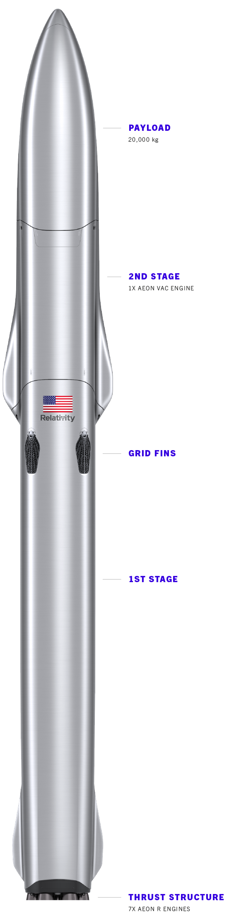
Pictures

Slide 4
3D printing in the dental industry
Dentists have started adopting additive manufacturing to speed up and improve the process of creating pretty much everything from dentures to crowns to nightguards to sports mouthguards
A company called Xact Metal sells 3D printers specifically designed for printing dental products, it also comes with special software that can communicate with other dental industry software and data
https://www.engineering.com/story/3d-printing-is-transforming-the-dental-industry

Slide 5
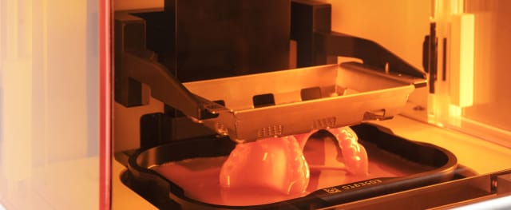
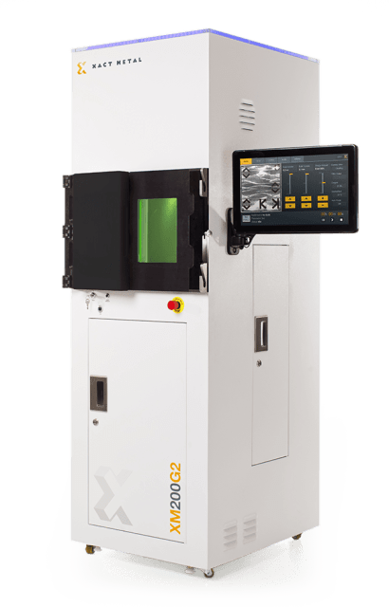

Slide 6
3D printing in Porsche products
The automotive industry has been using additive manufacturing for prototypes and models for a long time, but never has it been used for the final product until now!
Porsche is using 3D printing to create custom seats
Right now customization is limited, but they plan to increase customization so you can get a seat that matches the contours of your body
Other automotive companies like Toyota have been using 3D printing for spare parts

Slide 7
